Slide 1
Fake News Detection On YouTube Videos
1
ID-123
BSCS-6A
25th June,2021
Sir Shoaib Malik
180978. | Maryam Munir
181030. | Qurat-Ul-Ain
BSCS-6A
Dr. Awais Ahmed
M. Usman

Slide 2

Table of Contents
Introduction
Problem Statement
Project Objectives & Applications
Literature Review
Initial Methodology (Flow diagram)
Tools and Technologies
Gantt Chart
References (For Research Projects)

Slide 3

Introduction
Fake news is a form of news that misleads or misguides the people.
Due to the rapid increase of fraud content on YouTube ,the number of fake news articles is increasing day by day.

Slide 4

Types of Data in Fake News
There are two main types of fake news:
Visual based representation:

Slide 5
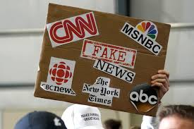
Linguistic based representation:

Slide 6
Problem Statement
YouTube video titles often do not match their content,
and also there is a possibility of fake content in videos as shown in visual base representation of fake news which often leads to fake news.

Slide 7

Project Objectives & Applications
This project aims to
Find correctness of given data
Data Preprocessing
Deep Learning Algorithms
Natural Language Processing
Training and testing of model
Analysis of results
Writing Research Paper

Slide 8
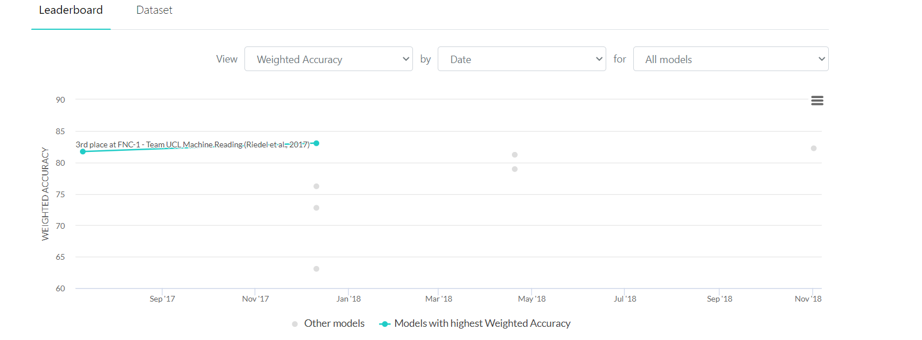
DataSet
Fake News Challenge (FNC-1) Data by Craig Silverman

Slide 9
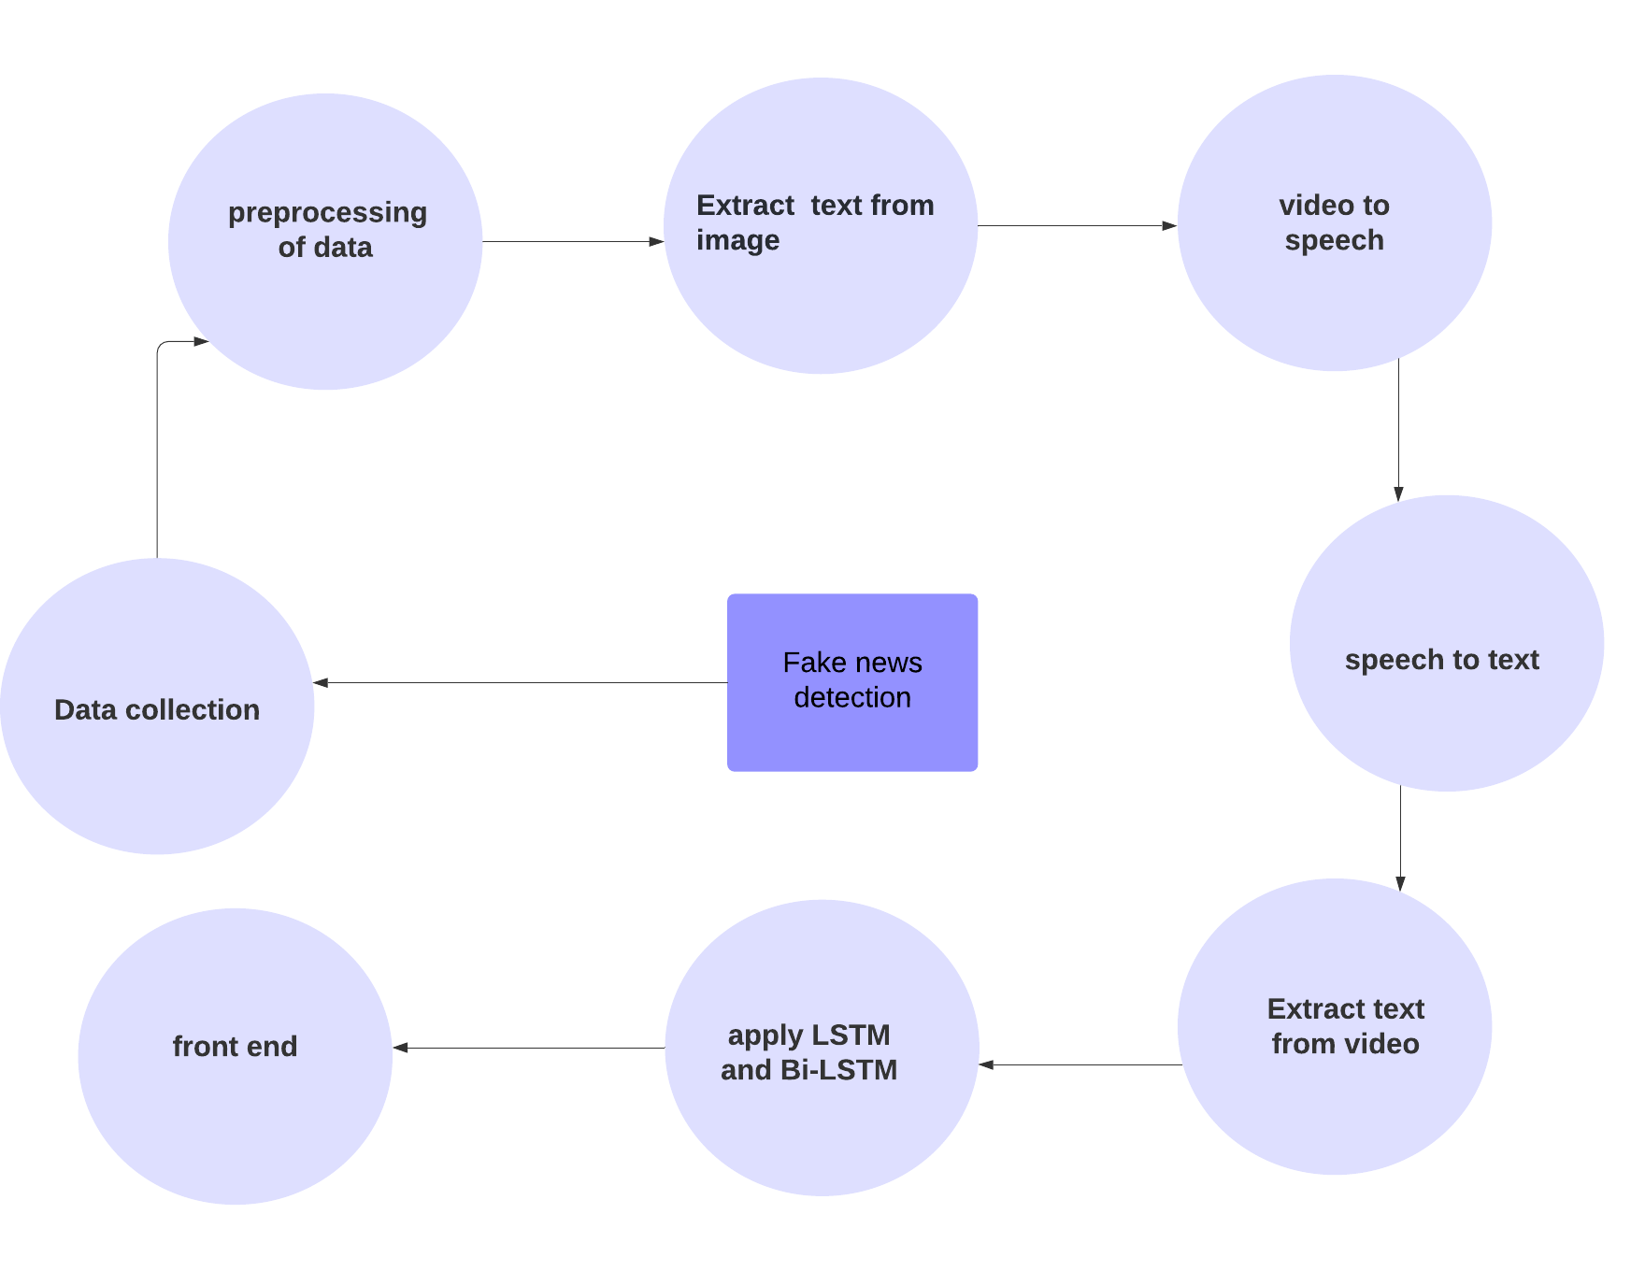
Initial Methodology (Flow diagram)

Slide 10

Tools and Technologies
Programming Language – Python 3
Programming Environment –Anaconda ,Visual Studio Code

Slide 11

Gantt Chart

Slide 12
References (For Research Projects)
Aswini Thota, Priyanka Tilak, Simrat Ahluwalia, Nibrat Lohia,”Fake news detection: A deep learning approach”, https://scholar.smu.edu/datasciencereview/about.html
Anshika Choudhary, Anuja Arora,”Linguistic feature based learning model for fake news detection and classification,Expert Systems with Applications”,Volume 169,2021,114171,ISSN 0957-4174 https://doi.org/10.1016/j.eswa.2020.114171.
G. Purna Chandar Rao, et. al. ,” A Research on Online Fake News Detection using Machine Learning Techniques”
https://doi.org/10.17762/turcomat.v12i10.4899
Mohammad Mahyoob, Jeehaan Algaraady, Musaad Alrahaili,”Linguistic-Based Detection of Fake News in Social Media”, http://www.ccsenet.org/journal/index.php/ijel/article/view/0/44204
Singhania S., Fernandez N., Rao S. (2017) 3HAN: A Deep Neural Network for Fake News Detection. In: Liu D., Xie S., Li Y., Zhao D., El-Alfy ES. (eds) Neural Information Processing. ICONIP 2017. Lecture Notes in Computer Science, vol 10635. Springer, Cham. https://doi.org/10.1007/978-3-319-70096-0_59
Saikh T., Anand A., Ekbal A., Bhattacharyya P. (2019) A Novel Approach Towards Fake News Detection: Deep Learning Augmented with Textual Entailment Features. In: Métais E., Meziane F., Vadera S., Sugumaran V., Saraee M. (eds) Natural Language Processing and Information Systems. NLDB 2019. Lecture Notes in Computer Science, vol 11608. Springer, Cham. https://doi.org/10.1007/978-3-030-23281-8_30
Jwa, H., Oh, D., Park, K., Kang, J. M., & Lim, H. (2019). exBAKE: Automatic fake news detection model based on Bidirectional Encoder Representations from Transformers (BERT). Applied Sciences (Switzerland), 9(19), [4062]. https://doi.org/10.3390/app9194062

Slide 13

Do you have any Questions?

